Slide 1
2016 Annual Meeting Agenda
President – Accomplishments, Initiatives (7:05-7:15)
  Minutes from 2015 BOD Meeting
  Repair of drainage issue at Lot 59
  Award of landscaping/maintenance contract to new contractor
  Timeline for assessment mailing/late fees and policy/attorney fees
  Establishment of Referral List on Website
  BOD Membership Request and Contracted Management Potential
Vice-President (7:15-7:25) – Management Reserve
  Landscaping front entrance
Treasurer (7:25-7:30)
  2015 Expenditures
  2016 Budget
  2017 Annual Dues
  Report of Financial Committee (7:30-7:35)
Continuing Business (7:30-7:45)
  Mosquito Control
  Rowell house
  Yard Sale Planning
  Volunteer Acknowledgement
Membership votes on proposed expenditures (7:45-7:50)

Slide 2
2015 BOD Mtg Minutes
All officers gave reports per the agenda.
Maintenance Contract:
  The use of LED lights was discussed in lieu of solar lighting previously proposed and approved. Additional concerns over the maintenance of the Solar lighting were discussed and were the main reason for discontinuing the approach. The BOD will contact Dennis Mara for the use of LED lighting, determine cost and implement.
    Status: No action has been taken yet.
Member Voting for BOD Expenditures:
  Sandblasting front entrance signs: was approved up to the amount of $1250 without further consult from members. An approved source of the work is required.
    Status Another method of cleaning the entrance was found, for a total cost of $300.
  Front Entrance Flowers: $500 was approved for planning / planting Bulbs / Hostas or other flowers. The BOD will consult Dennis Mara.
    Status: $500 was not enough money for supplies/labor to make a marked difference to the appearance of the front entrance. Also, adding bulbs without a formal landscaping plan would be impractical. Additionally, funds were needed for repair of the drain on Lot 59.

Slide 3
2015 BOD Mtg Minutes
Member Voting for BOD Expenditures (continued):
  Rip Rap at the end of Pastor Court was approved.
  Tree replacement was approved upon need ( up to 2 trees and stump grindings)
  Mosquito Spraying was unanimously disapproved.
  Advertising for the community yard sale was approved ( May 16th , Jun 6th rain out date)
BOD Nominations
  All existing BOD members were voted back in unanimously.
  One BOD member will be resigning for health reasons
Attendance: 16 Members were present at the meeting ( including the BOD). 7 proxy votes were recorded.

Slide 4
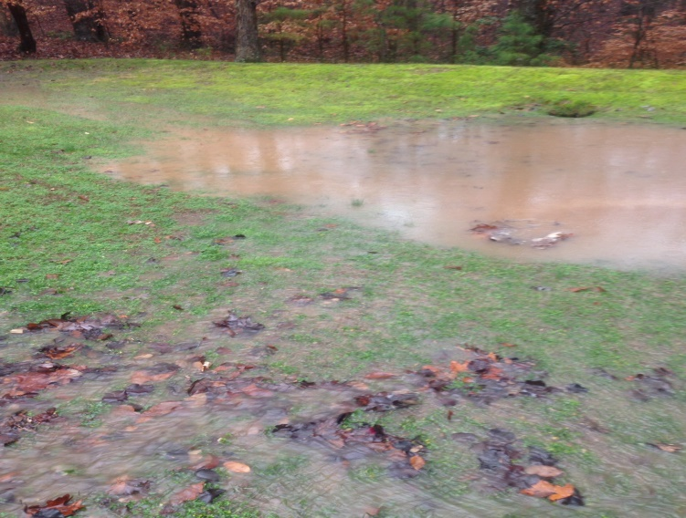
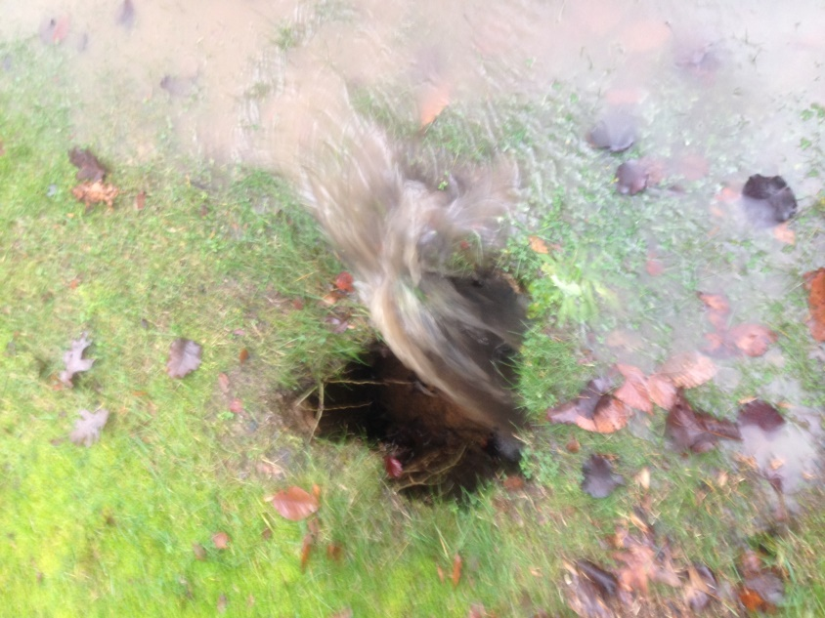
Drainage at 39305 Persimmon Creek Rd
Contractor: Tennyson
Scope of Work: Sinkhole was due to tear in the filter lining (vs. a break in the water pipe). The tear was repaired, hole filled, and ground reseeded with grass.
Cost: $1500.00??

Slide 5
Minutes from the 4/22/14
Annual Meeting
The 2013 Annual meeting minutes were reviewed. No questions / comments were received.
Accomplishments from 2013 were reviewed. Mitigation of community concerns regarding the Rowell house were included , although this activity occurred in 2014.
An overview of the storm drain repair completed by the Santana residence along Persimmon Creek Road was provided. Mr. Santana expressed concerns that the repairs were not conducted to required specifications.
  The BOD recorded an action to research specifications from the county and determine if further improvements were required.
    Result: Specifications were discussed with the county and there were no apparent concerns for the storm drain. All drains were surveyed by the county and deemed to be in good condition.

Slide 6
2016 Landscaping Contract
Contacted 4 sources for bids:
  Company that had contract before My3Sons
  Company that does landscaping for Ben Oaks
  Company that does landscaping for Academy Hills and Chestnut Hills housing developments
  Company pulled out of the phone book
Results:
  First company did not bid
  Second company did not return phone calls until after contract let
  Bids from other 2 companies
 | Buddy B’s | Custom Landscaping
Maintain Entrance | $4450.00 | $10150.00
Tree Replacement | $1020.00 | $1520.00
Landscaping | $2170.00 | ~$1700.00
Total | $7640.00 | $13470.00

Slide 7
2016 Landscaping Contract
Landscaping –
  Proposed cost for landscaping would include removing some old plants, adding new plants and bulbs as required.
  Some means of watering would be required for at least one year –
    Option 1 – METCOM, $1,000 deposit for meter, $250 for 60 days, plus water.
    Option 2 – METCOM, $1,000 deposit for meter, $520/year for 3 years, plus water.
    Option 3 – Buddy B’s has a water truck and water, as needed, for $80 a trip. He estimates 5 trips the first year.

Slide 8
Dues Policy / Due Date
2016 Annual Assessment ($105.00)
Annual Dues
  Statements mailed out ~ 1 Dec every year.
  Due Date: January 31st of the New Year
  Payment due date / amount communicated through out year.
  Payment Late Fees Begin February 15
    $15.00 + 4.7 Cents per day ( 18% Annum)
  Late fee notice and payment reminder mailed out ~ 2 weeks after February 15.
    15 days to respond. If no response, Demand letter sent from resident agent ( Attorney Fees added to Account at rate of $200 / hr for any work related to each individual account)
    If no response to demand letter, claim filed in court.
The Payment Schedule has been the same since for at least 4 years now. No changes are planned.

Slide 9
Referral List for Website
At suggestion of Candace Patterson, a referral list was established on the website.
  If a home owner wants to suggest someone for the list (i.e., painter, landscaping, handyman, babysitter), they just need forward the information to persimmon_hills@yahoo.com and they will be included.
  If a home owner is looking for someone to do a specific job that isn’t already listed on the referral list, forward an e-mail stating the type of work required, and it will be circulated throughout the Association to an effort to find a referral.

Slide 10
BOD Membership Request
Current Officers
  John Gruzenski (President/Secretary/Treasurer)
  Joan Devlin (Vice President/Secretary/Web Content)
  Robert Graham (Member at Large)
2017 Look Ahead
  Joan Devlin Planning to Retire from Board in 2017
    Will require officer replacement
  Recommended Board Size is 5
  Lack of Community Involvement may require contracted services
    Increase in Annual Dues Likely
  Looking for Two Additional Officers This Year
    Secretary
    Treasurer

Slide 11
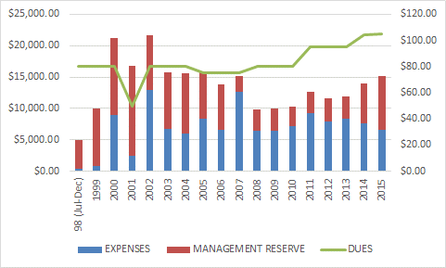
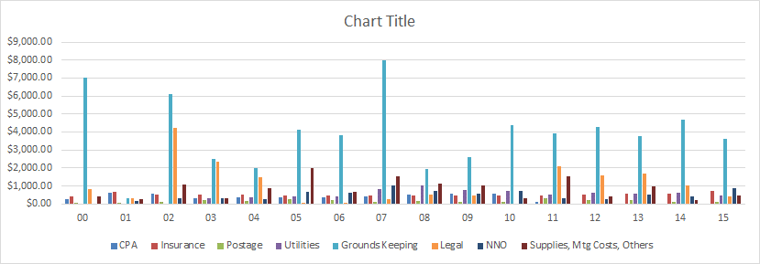
$7,000.00 for grounds keeping in 2000
$6,100.00 for grounds keeping and $4,204.09 for legal fees in 2002
$3,815.11 in legal fees for 2003/2004 – received $ back
$8,811.94 for landscaping in 2005-2007
$6,660.90 for work on the front entrance in 2007 – received $1500 from Marrick to off-set cost
Note: Grounds keeping includes landscaping and costs for storm system repair (i.e., riprap)

Slide 12
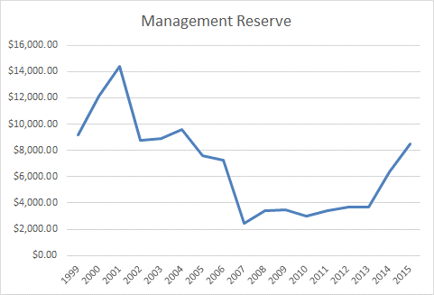
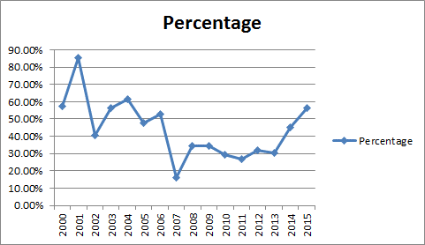
Top Chart - management reserve in dollars by year
Bottom Chart – percent of total budget that was allocated to management reserve

Slide 13
2015 Expenditures
- $2625.00 of 2015 Dues were Deposited in December and is included in Beginning Balance for January 2015

Slide 14
2016 Projected Expenditures
$1500.00 for Drain Repair at 39305 Persimmon Creek Road
$6620.00 for Front Entrance Maintenance and Landscaping
2015 Rates for Electricity and Insurance
4 Member Payments Outstanding as of 3/27/16
Unbalanced Budget Projected

Slide 15
Other Financial Business/ Other Business
2017 Annual Dues
  Maintenance Contract Increase of approximately $1,000/year
  Inflation
  Final Expenditures will Determine Potential for Dues Increase. ($110 or $115 Under Consideration)
Rowell House Status
  Foreclosure Recorded in December 2015
  Law prevented collection of any prior year dues / late fees
  (~ $1000.00)
  Deutsche Bank National Trust Company now owns property and has paid 2016 dues
Financial Committee Report
Yard Sale Planning – Members to Discuss Date
Volunteer Acknowledgement
  Tony Bowles – Flags
  Pat Bowles, Gloria Fusco, and Judy Ramsey - Financial Committee

Slide 16
Unplanned Expenditures
Drainage issues:
  Repair of drain on Lot 59, approximately $1,500.
  Drain issue with Lot 18, cost estimate unknown.
  Rip-rap for drains at front estimate, cost estimate unknown.
The Board proposes a one-time special assessment $20 per household to pay for these expenses.

Slide 17
Potential Expenditures
Re-landscaping front entrance:
  Complete re-landscaping for a cost of $2,170 for landscaping, and an additional $500 for water
  No landscaping.
  Some landscaping – the Association proposes a budget and the contractor provides what he can for that amount.

Slide 18
PHIA BOD Nominations
The BOD is looking for a minimum of 2 new members.

