Slide 1

PHIA 2017 Agenda
President – Accomplishments, Initiatives (7:05-7:15)
  Minutes from 2016 BOD Meeting
  Repair of drainage issue at Lot 18
  Award of landscaping/maintenance contract to new contractor
  Timeline for assessment mailing/late fees and policy/attorney fees
  BOD Membership Request and Contracted Management Potential
Vice-President (7:15-7:25) – Management Reserve
  Landscaping front entrance
Treasurer (7:25-7:30)
  2016 Deposits / Expenditures
  2017 Budget
  2017 Annual Dues
  Report of Financial Committee (7:30-7:35)
Continuing Business (7:30-7:45)
  Rowell house
  Yard Sale Planning
  Volunteer Acknowledgement
Membership votes on proposed expenditures (7:45-7:50)

Slide 2
Minutes from 2016 BOD Meeting
The President discussed accomplishments and initiatives from the previous year (2016).
Minutes for the 2016 BOD Meeting were presented – no comments.
There was discussion on repair to a drain on Lot 59. The liner by the drain had been broken and had to be repaired. The final cost was $1500 .
The next landscaping contract was awarded. My3Sons, who previously had the contract, did not bid due to the retirement of the owner. Four bids were solicited, 2 were received. The bid prices were:
Maintenance of the front area $4,450 $10,150
Replace 2 trees $1,020 $ 1,520
Re-landscape front entrance $2,170 $ 1,700
Buddy B’s was awarded the contract.

Slide 3
Minutes from 2016 BOD Meeting
Reviewed the timeline for sending out notices of dues, late fees, etc.
Discussed establishment of Referral List on website.
Discussed BOD membership and membership needs.
Retirement of the financial committee was discussed and duties of the committee were reviewed.
The Treasurer and committee reviewed the budget
  The management reserve at the end of the year was projected to be $6,602.55.
  The status of the Rowell house was discussed.
  The potential need to raise the annual dues based on an increase in landscaping fees was discussed.
The Treasury Committee gave a report and found no issues with the books

Slide 4
Dues Policy / Due Date
Annual Dues (2016 assessment $105.00)
  Statements mailed out ~ 1 Dec every year.
  Due Date: January 31st of the New Year
  Payment due date / amount communicated through out year.
  Payment Late Fees Begin January 31st
    $15.00 + 4.7 Cents per day ( 18% Annum)
  Late fee notice and payment reminder mailed out ~ 2 weeks after February 15.
    15 days to respond. If no response, Demand letter sent from resident agent ( Attorney Fees added to Account at rate of $200 / hr for any work related to each individual account)
    If no response to demand letter, claim filed in court.
The Payment Schedule has been the same since for at least 4 years now. No changes are planned.

Slide 5
Landscaping Contract
Contacted 3 sources for bids:
  Company that is presently doing the landscaping
  Company that does landscaping for Ben Oaks
  Company pulled out of the phone book
Results:
  Third company did not bid
  Bids from other 2 companies
 | Buddy B’s | Buddy Lee Landscaping
Maintain Entrance | $4230.00 | $4355.00
Tree Replacement | $1020.00 | $770.00
Landscaping | Incomplete | ~$420.00
Total | $5250.00 | $5545.00

Slide 6
Landscaping Contract
Landscaping –
  Proposed cost for landscaping would include removing some old plants, adding new plants and bulbs as required.
  Some means of watering would be required for at least one year –
    Contract has a water truck and water, as needed, for $60 a trip.

Slide 7
Over Time Expenses
$7,000.00 for grounds keeping in 2000
$6,100.00 for grounds keeping and $4,204.09 for legal fees in 2002
$3,815.11 in legal fees for 2003/2004 – received $ back
$8,811.94 for landscaping in 2005-2007
$6,660.90 for work on the front entrance in 2007 – received $1500 from Marrick to off-set cost
Note: Grounds keeping includes landscaping and costs for storm system repair (i.e., riprap)

Slide 8
2016 Reserve / %
Top Chart - Management reserve in dollars by year
Bottom Chart – Percent of total budget that was allocated to management reserve

Slide 9
2016 Deposits / Expenditures
2016 PHIA Deposits and Expenditures
 |  |  |  |  |  |  |  |  |  |  | 2015 Balance |  | $8,511.25
DEPOSITS | Jan | Feb | Mar | Apr | May | Jun | Jul | Aug | Sep | Oct | Nov | Dec | 2016 Deposits
Dues Collected | $3,885.00 | $3,780.00 | $315.00 | $473.76 |  | $105.00 |  |  |  | $236.42 |  |  | $8,795.18
EXPENSES | Jan | Feb | Mar | Apr | May | Jun | Jul | Aug | Sep | Oct | Nov | Dec | 2016 Expenses
Accounting Fee |  |  |  |  |  |  |  |  |  |  |  |  | $0.00
Bank Charges |  |  |  |  |  |  |  |  |  |  |  |  | $0.00
Grounds Maintenance |  |  |  |  |  | $2,803.26 | $573.34 | $286.67 | $286.67 | $286.67 | $286.67 |  | $4,523.28
Mosquito Control |  |  |  |  |  |  |  |  |  |  |  |  | $0.00
Drain Maintenance |  |  |  |  |  |  |  |  |  |  |  |  | $0.00
Insurance |  |  |  |  |  |  |  |  | $699.00 |  |  |  | $699.00
Legal Fees |  |  |  |  |  |  |  |  |  |  |  |  | $0.00
National Night Out |  |  |  |  |  |  |  | $884.94 |  |  |  |  | $884.94
Office Supplies |  |  |  |  |  |  |  |  |  |  |  |  | $0.00
Postage/ Post Off Box |  | $49.00 |  |  |  |  |  | $48.00 |  |  |  | $47.00 | $144.00
Utilities | $53.41 | $56.97 | $44.46 | $50.34 | $50.71 | $43.11 | $41.62 | $38.47 | $30.99 | $28.41 | $30.82 | $56.05 | $525.36
Annuall Meeting |  |  |  | $50.00 |  |  |  |  |  |  |  |  | $50.00
MISC* |  |  |  | $145.77 |  |  |  |  |  |  | $26.59 |  | $172.36
Total Exp | $53.41 | $105.97 | $44.46 | $246.11 | $50.71 | $2,846.37 | $614.96 | $1,258.08 | $1,016.66 | $315.08 | $344.08 | $103.05 | $6,998.94
 |  |  |  |  |  |  |  |  |  |  | 2016 End Balance |  | $10,307.92

Slide 10
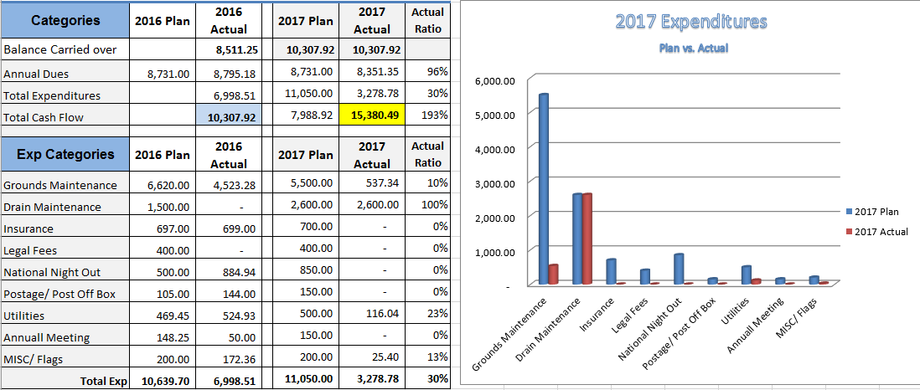
2017 Budget vs. Actual

Slide 11
Other Financial Business
2018 Annual Dues
  Final Expenditures will Determine Potential for Dues Increase.
Rowell House Status
  Foreclosure Recorded in December 2015
  Law prevented collection of any prior year dues / late fees
  (~ $1000.00)
  Deutsche Bank National Trust Company now owns property and has paid 2016 dues
  Recent communications with a title company indicate the property will be sold soon if it hasn’t already
Financial Committee Report
  2016 Budget approved

Slide 12
BOD Membership Request
Current Officers
  John Gruzenski (President)
  Joan Devlin (Vice President/Web Content)
  Don Rauhauser (Treasurer)
  Cathy McGowan-Raley (Secretary)
2017 Look Ahead
  Joan Devlin Retiring from Board in 2017
    Will require officer replacement
  Recommended Board Size is 5
    All current officers planning to continue except Joan.
  Looking for Two Additional Officers This Year
    TBD (Member at Large)
    TBD (Vice President )

Slide 13
Other Business
Yard Sale Planning – Members to Discuss Date
Volunteer Acknowledgement
  Tony Bowles – Flags
  Cathi Telli and Joan Devlin - BOD
  Nita Collier, TBD - Financial Committee

