Slide 1

2018 Annual Meeting Agenda
President – Accomplishments, Initiatives (7:05-7:15)
  Minutes from 2017 BOD Meeting
  Award of landscaping/maintenance contract to new contractor
  Timeline for assessment mailing/late fees and policy/attorney fees
  Front Entrance Lighting
Vice-President (7:15-7:25) – Management Reserve
  Landscaping front entrance
Treasurer (7:25-7:30)
  2017 Expenditures
  2018 Budget
  2019 Annual Dues
  Report of Financial Committee (7:30-7:35)
Continuing Business (7:30-7:45)
  Yard Sale Planning
  Volunteer Acknowledgement
Membership votes on proposed expenditures (7:45-7:50)

Slide 2
Front Entrance Lighting
Maintenance Contract Bids Collected:
  Buddy B - $3,110
  Five Point Landscaping - $4,145
  Buddy Lee - $4,595
  Clean Cut Crew - $4,760
Lighting Estimates Collected
  Josh Jenkins Enterprise- $2,100 new wiring
  Powertech Electric - $2,900 new wiring $1,000 solar
  Clean Cut Crew - $4,000+ new wiring, TBD solar

Slide 3
Minutes from the 2017 BOD Meeting
Reviewed the status of drain repairs near Lot 18.
Reviewed the timeline for sending out notices of dues, late fees, etc.
Reviewed maintenance contract bids and contractor selection.
Discussed BOD membership and membership needs.
The Treasurer and committee reviewed the budget
  Reviewed 2016 budget execution and 2017 budget forecast
  Discussed questions regarding insurance coverage
  Solicited input for potential future drain repairs
The Treasury Committee reported no issues with financial records. Acknowledged new members of the Financial Committee.
Discussed plans for tree replacement on Persimmon Creed Rd as well as a variety of other topics to inform the community ( metal roofs, storm drains, mosquito spraying, mulch sale, speed bumps )

Slide 4
Dues Policy / Due Date
2019 Annual Assessment ($105.00)
Annual Dues
  Statements mailed out ~ 1 Dec every year.
  Due Date: January 31st of the New Year
  Payment due date / amount communicated through out year.
  Payment Late Fees Begin January 31st ($15.00 late fee)
    $15.00 + 4.7 Cents per day ( 18% Annum)
    Late fee notice and payment reminder mailed out ~ 2 weeks after February 15.
    15 days to respond. If no response, Demand letter sent from resident agent (Attorney Fees added to Account at rate of $200 / hr for any work related to each individual account)
    If no response to demand letter, claim filed in court or the association may elect to place a lien on the property
The Annual Assessment has been the same since for 4 years now. No changes are planned.

Slide 5
2017 Budget

Slide 6
Budget / Expenditures Overtime
$105.00 Annual Dues for 4 years
$2,600.00 for Drain Maintenance

Slide 7
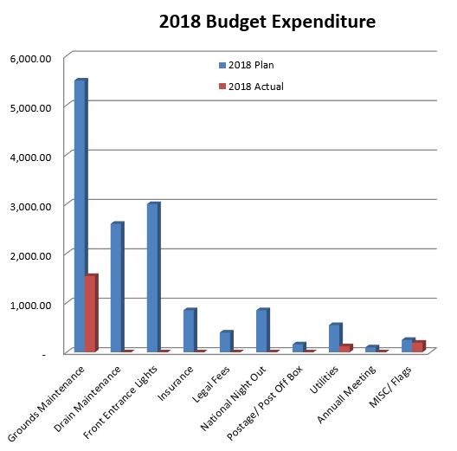
2018 Budget
Categories | 2017 Plan | 2017 Actual |  | 2018 Plan | 2018 Actual | Actual Ratio
Balance Carried over |  | 10,307.49 |  | 10,274.44 | 10,274.44
Annual Dues | 8,820.00 | 9,327.36 |  | 8,820.00 | 8,567.11 | 97%
Total Expenditures |  | 9,360.41 |  | 14,260.00 | 1,860.05 | 13%
Total Cash Flow |  | 10,274.44 |  | 4,834.44 | 16,981.50
Exp Categories | 2017 Plan | 2017 Actual |  | 2018 Plan | 2018 Actual | Actual Ratio
Grounds Maintenance | 5,500.00 | 3,978.04 |  | 5,500.00 | 1,544.68 | 28%
Drain Maintenance | 2,600.00 | 2,600.00 |  | 2,600.00 | - | 0%
Front Entrance Lights |  |  |  | 3,000.00 | - | 0%
Insurance | 700.00 | 849.00 |  | 850.00 | - | 0%
Legal Fees | 400.00 | 400.00 |  | 400.00 | - | 0%
National Night Out | 850.00 | 761.06 |  | 850.00 | - | 0%
Postage/ Post Off Box | 150.00 | 152.56 |  | 160.00 | - | 0%
Utilities | 500.00 | 544.35 |  | 550.00 | 121.99 | 22%
Annuall Meeting | 150.00 | 50.00 |  | 100.00 | - | 0%
MISC/ Flags | 200.00 | 25.40 |  | 250.00 | 193.38 | 77%
Total Exp | 11,050.00 | 9,360.41 |  | 14,260.00 | 1,860.05 | 13%

Slide 8
BOD Membership Request
Current Officers
  John Gruzenski (President)
  Joshua Langhus (Vice President)
  Don Rauhauser (Treasurer)
  Cathy McGowan-Raley (Secretary)
  VACANT(Member at Large)
Additional Members Welcome

Slide 9
Other Financial Business/ Other Business
Annual Dues
  Final Expenditures will Determine Potential for Dues Increase for 2019.
  Three homeowners have not paid 2018 dues.
Financial Committee Report
Yard Sale Planning – Members to Discuss Date
House Vacant / Grass not mowed
Volunteer Acknowledgement
  Tony Bowles – Flags
  Nita/Bob Collier, Carlotta Catanese - Financial Committee

